Slide 1

Run-I Single-top measurements at CMS
Rebeca Gonzalez Suarez
University of Nebraska, Lincoln

Slide 2
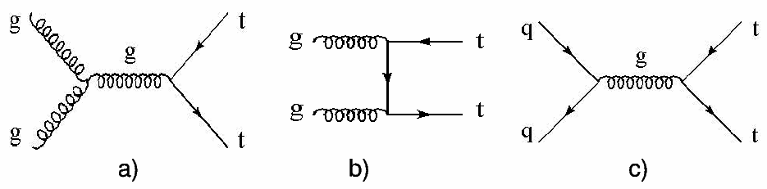
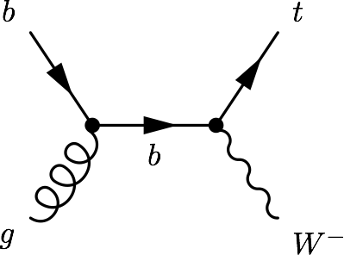
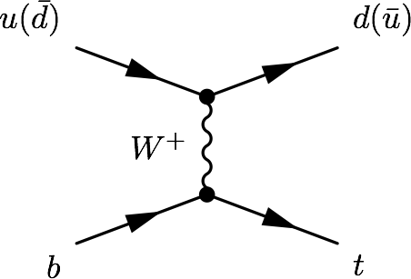
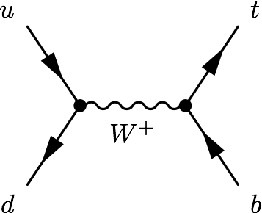
Top quarks at the LHC
At the LHC, top quarks are produced mainly in ttbar pairs
strong interaction
Alternative mode, at a lower rate: Single top quark production
electroweak interaction
Three main single top process:
t-channel, tW associated production, s-channel
σ [pb] | ttbar | t-channel | tW | s-channel
Tevatron (1.96TeV) | 7.08 | 2.08 | 0.22 | 1.046
LHC @ 7TeV | 177.31 | 63.89 | 15.74 | 4.29
LHC @ 8TeV | 252.89 | 84.69 | 22.2 | 5.24
LHC @ 13TeV | 831.76 | 216.99 | 71.2 | 10.32

Slide 3
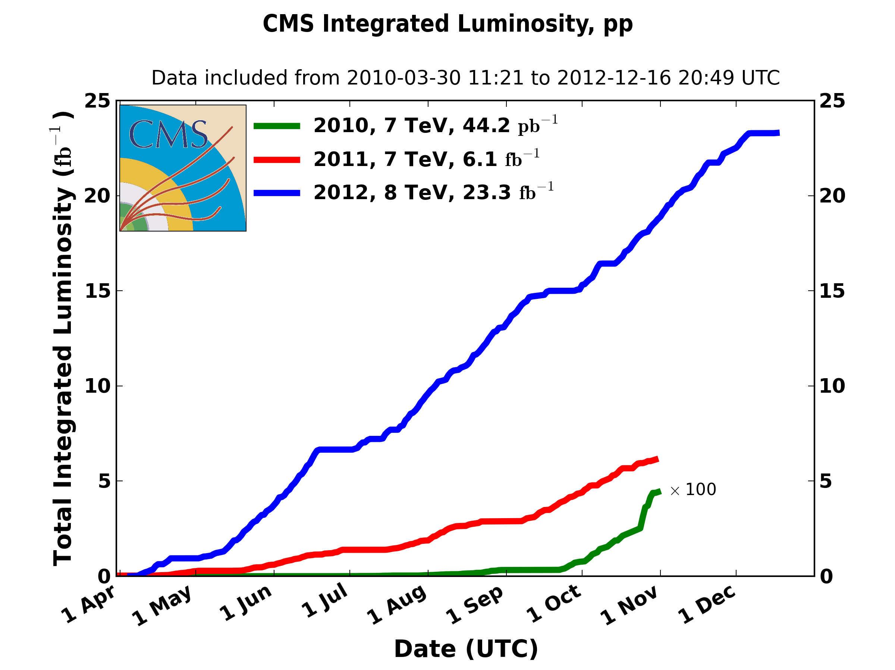
Run-1of the LHC in tops
Top quarks were observed for the first time at the Tevatron → in1995 via ttbar, in 2009 via single top; but the LHC has been competitive since the start (first single top paper in 2011)
“The LHC is a top quark factory!”
- Every speaker at every talk about top quarks at the LHC
The Run-1 of the LHC lasted three years:
~5fb⁻¹ of pp collisions at 7TeV
~20fb⁻¹ at 8TeV
CMS then registered
More than 5M ttbar pairs
Around 2M of single top quarks (via t-channel)
Half a million of tW events
a bit more than 100K of s-channel events

Slide 4
Step 1
Study the three single top production modes and measure their production cross section

Slide 5
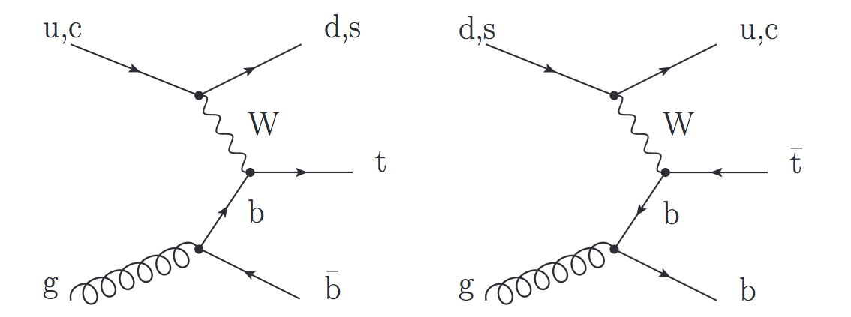
t-channel
Dominant process with the highest cross section at the Tevatron and the LHC
Final state studied: lepton + jets signature
Signal characterized by:
One isolated muon or electron
Missing transverse energy (MET)
A central b jet
light-quark jet from the hard scattering process (often forward)
Additionally, a second b jet produced in association to the top quark
Main backgrounds: W+jets, ttbar, multijet
Leptonic top decay

Slide 6
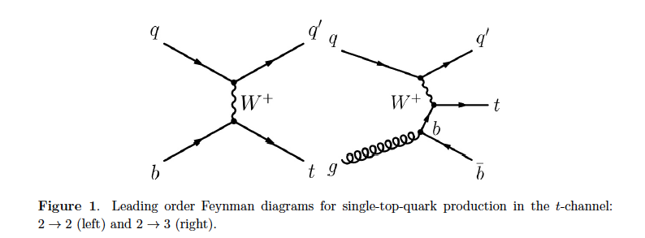
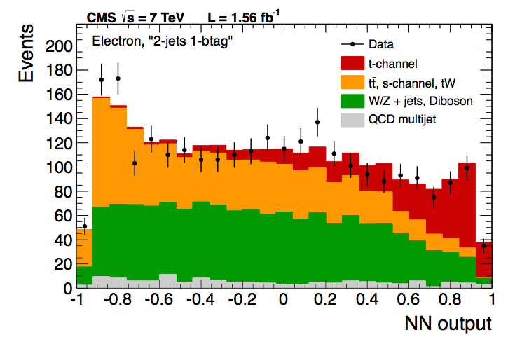
t-channel (7TeV)
At 7 TeV CMS measured the inclusive t-channel cross section
Using Multivariate methods (BDT, NN) and the shape of the pseudorapidity of the light jet, |η_{j’}|
Different regions defined
(jets, b-tag)
Multijet and W+jets background estimated from data
Statistical, systematic, and theory uncertainties on the same level
September 2012
JHEP 12 (2012) 035
arXiv:1209.4533
7TeV - 1.17 and 1.56 fb⁻¹

Slide 7
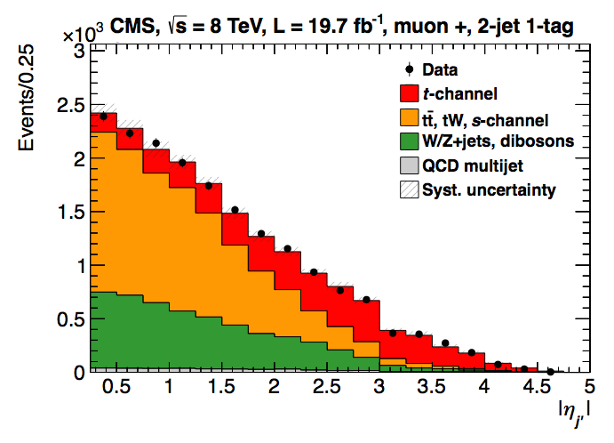
t-channel (8TeV)
At 8 TeV, the measurement was done using the |η_{j’}| analysis alone
Similar approach as for 7TeV, more data-driven (Multijet, W+jets, ttbar)
Full luminosity
Systematic dominated
main uncertainties:
Signal modeling (~6%)
and JES/JER/MET (~4%)
March 2014
JHEP 06 (2014) 090
arXiv:1403.7366
8 TeV - 19.7fb⁻¹

Slide 8
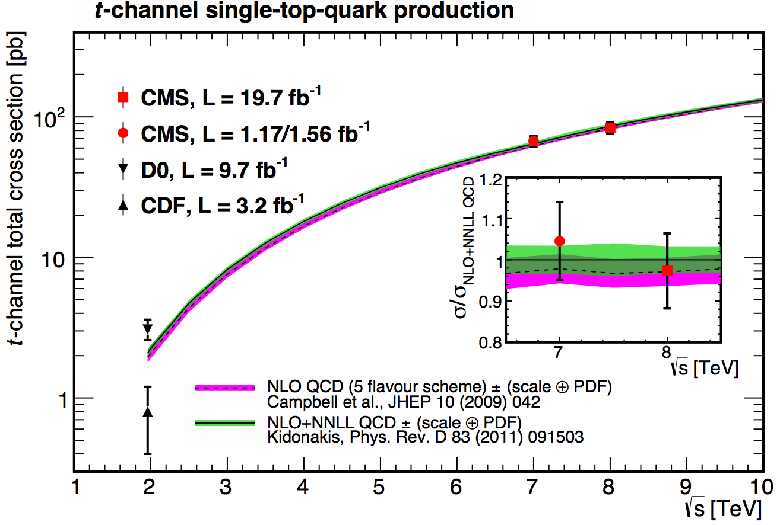
t-channel: results
7TeV | Measured | 67.2±3.7(stat)±3.0(syst)±3.5(th)±1.5(lumi) pb = 67.2±6.1 pb
 | Prediction | 63.89+2.91-2.52 (NLO, latest calculation)
8TeV | Measured | 83.6±2.3 (stat) ±7.4 (syst) pb
 | Prediction | 84.69+3.76 -3.23 (NLO, latest calculation)

Slide 9
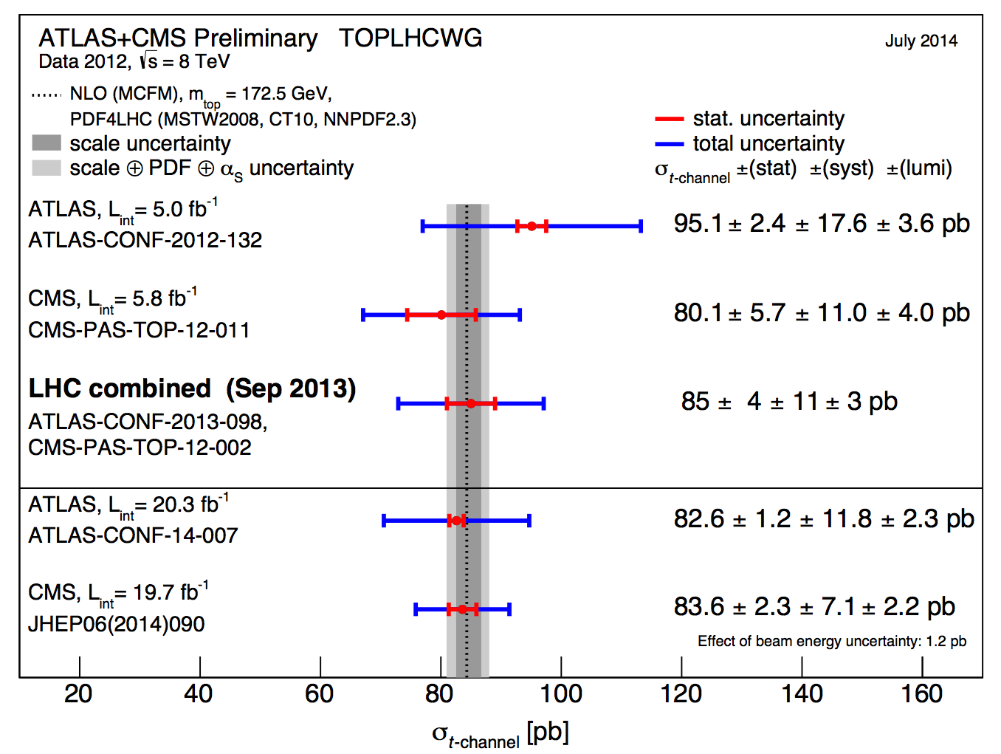
t-channel: combination
An LHC (ATLAS+CMS) combination was made at 8TeV
It was the first single top combination of the LHC
Sept. 2013
CMS-PAS-TOP-12-002

Slide 10
tW associated production
Single top process with the second largest cross-section at the LHC
Final state studied: dilepton signature
Signal events are characterized by:
Two opposite-sign, isolated leptons
Missing transverse energy (2 neutrinos in the final state)
A jet coming from a b decay
Backgrounds: ttbar (main challenge), DY

Slide 11
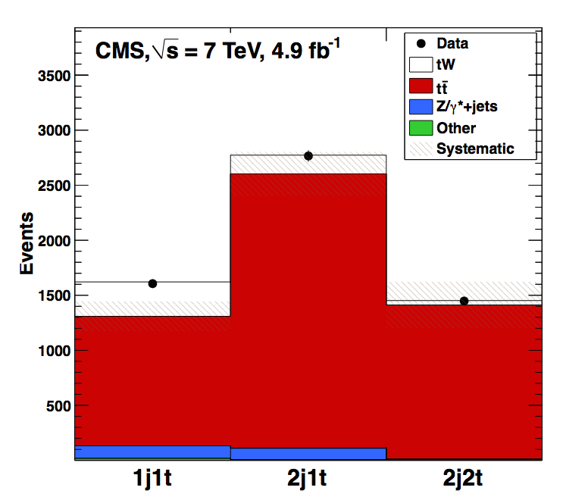
tW (7TeV)
Impossible to study before the LHC (very low cross section at he Tevatron) → At the LHC is still not easy
With 7TeV data, CMS reported evidence for the process
September 2012
Phys. Rev. Lett. 110 (2013) 022003
arXiv:1209.3489
4.0σ
7TeV - 4.9fb⁻¹

Slide 12
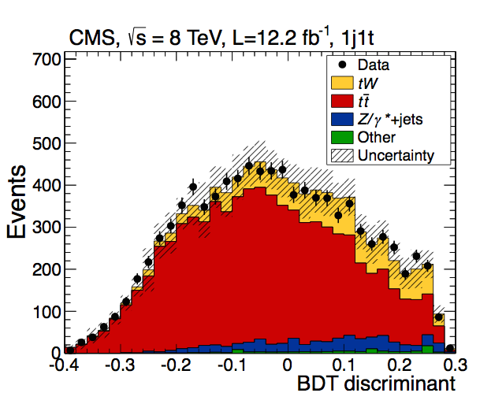
tW (8TeV)
At 8TeV the process was observed with a significance > 5 σ
7 TeV → cut-based, basic BDT
8TeV → cut-based, shape-based, more sophisticated BDT
At 8TeV the analysis is already not statistically limited
January 2014
Phys. Rev. Lett. 112 (2014) 231802
arXiv:1401.2942
6.1σ
8TeV - 12.2fb⁻¹

Slide 13
tW: results
The main challenge is the ttbar background
ttbar with 1 jet outside acceptance or misreconstructed → mimics perfectly the signal
→ not only very similar final states, also their diagrams mix at NLO
→ Main uncertainties come from theory modeling of ttbar
2 control regions were established
Use of variables related ‘loose’ jets
7TeV | Measured | σ_{tW} =16+5-4 pb
 | Prediction | σ_{tW} = 15.6±0.4±1.1 pb
8TeV | Measured | σ_{tW} = 23.4±5.4 pb
 | Prediction | σ_{tW} = 22.2±0.6±1.4 pb

Slide 14
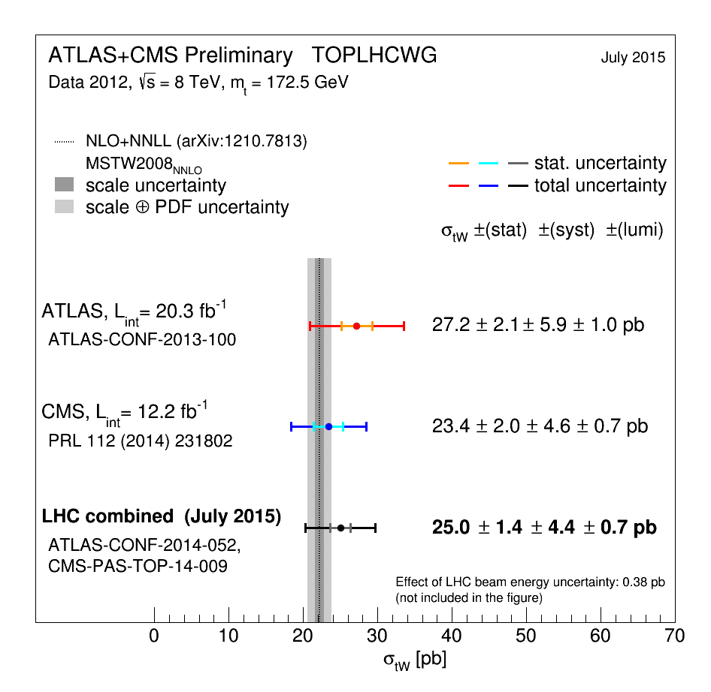
tW: combination
ATLAS+CMS tW combination at 8TeV also performed
September 2014
CMS-PAS-TOP-14-009

Slide 15
s-channel
Lowest cross-section at the LHC, more important at the Tevatron, where the study of data after the shutdown allowed for the observation of the process
Interesting production mode sensitive to new physics: W’ bosons, charged Higgs bosons
Very challenging final state: low cross-section, difficult to separate from backgrounds
Signal signature: lepton + jets
A lepton (e,µ) and MET from the decay of a W boson
Two jets with high transverse momentum originating from b-quarks
Main backgrounds: ttbar, W+jets, multijet
Phys. Rev. Lett. 112, 231803 (2014)

Slide 16
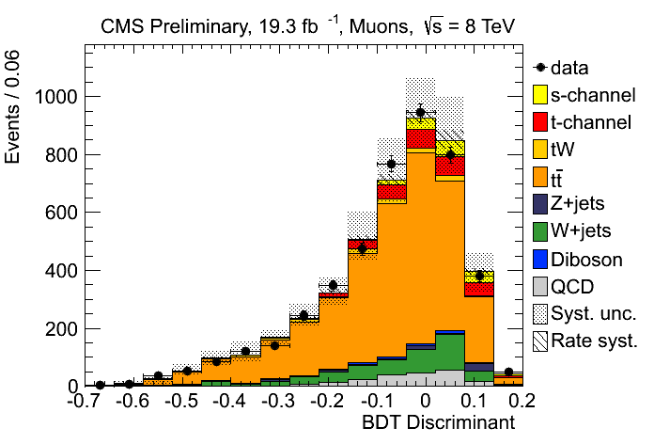
s-channel
CMS has a preliminary result at 8TeV
CMS-PAS-TOP-13-009
(November 2013)
Full lumi, e and µ
BDT
Difficult analysis
In Run-2 will be even harder
S/B is a bit better at 7TeV
σ [pb] | ttbar | s-channel
LHC (7 TeV) | 177.31 | 4.29
LHC (8 TeV) | 252.89 | 5.24
LHC (13TeV) | 831.76 | 10.32
σ_{s-channel} = 6.2±5.4(exp.)±5.9(th)pb = 6.2+8.0-5.1 pb (FC)
σ^{th}_{s-channel} = 5.55 ± 0.08 (scale) ± 0.21(PDF) pb (NNLL)
Upper limit of 2.1 (3.1,1.6) times the SM

Slide 17
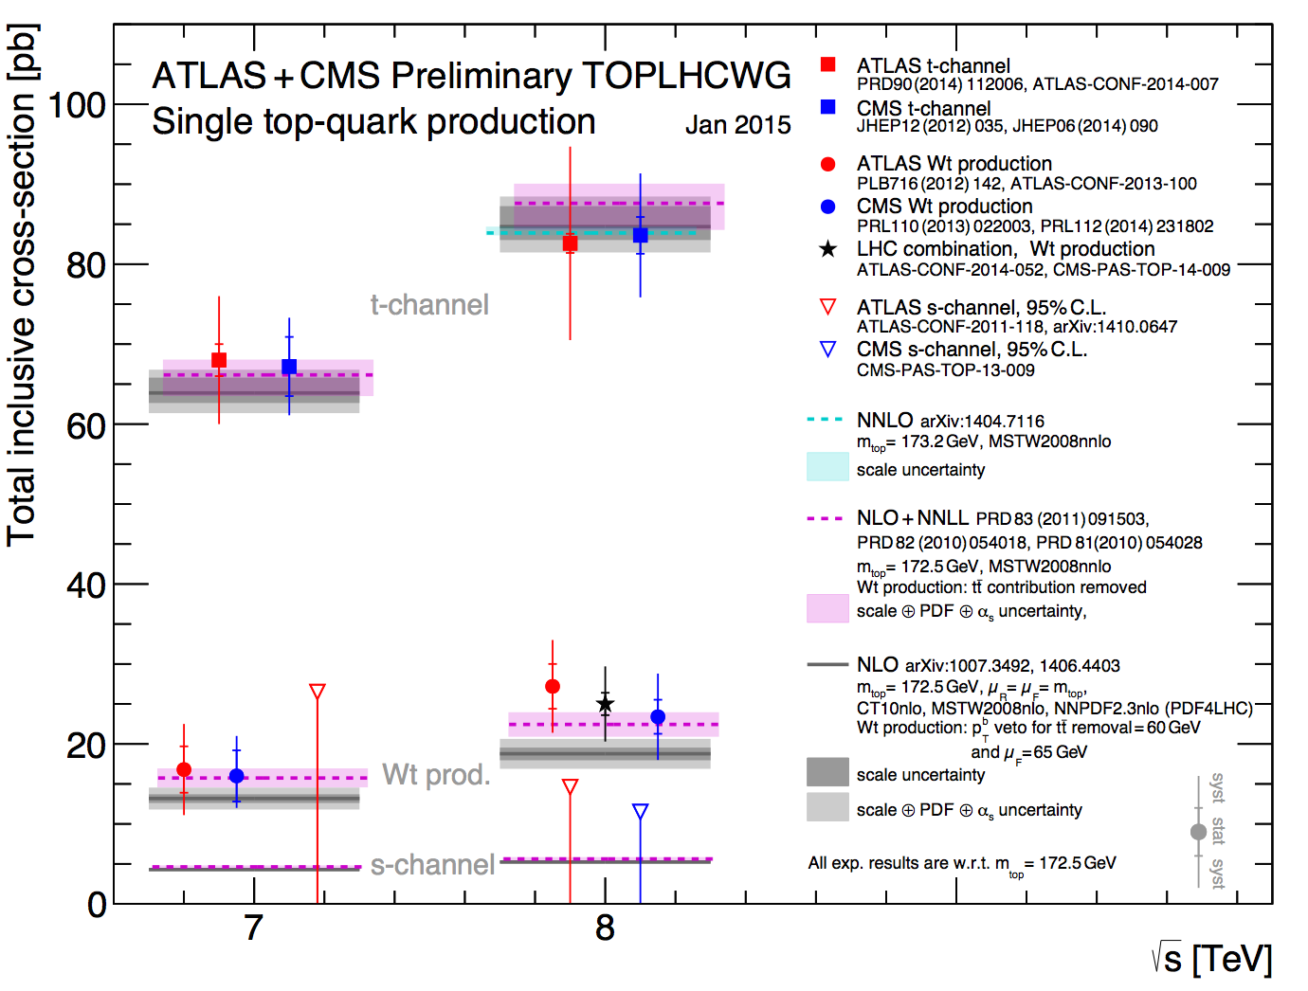
Run-1Summary

Slide 18

Step II
Measure SM properties in single top signatures
The single top production at the LHC is large enough to measure top properties in single top signatures
Complementary to ttbar
Another handle to test potential BSM phenomena
Valuable to get the full picture

Slide 19
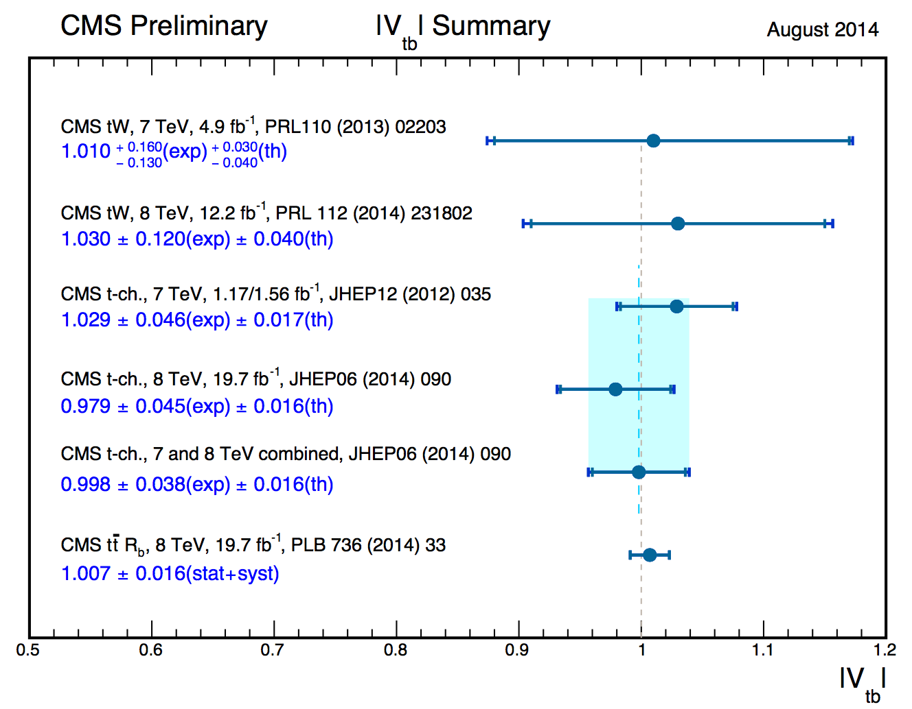
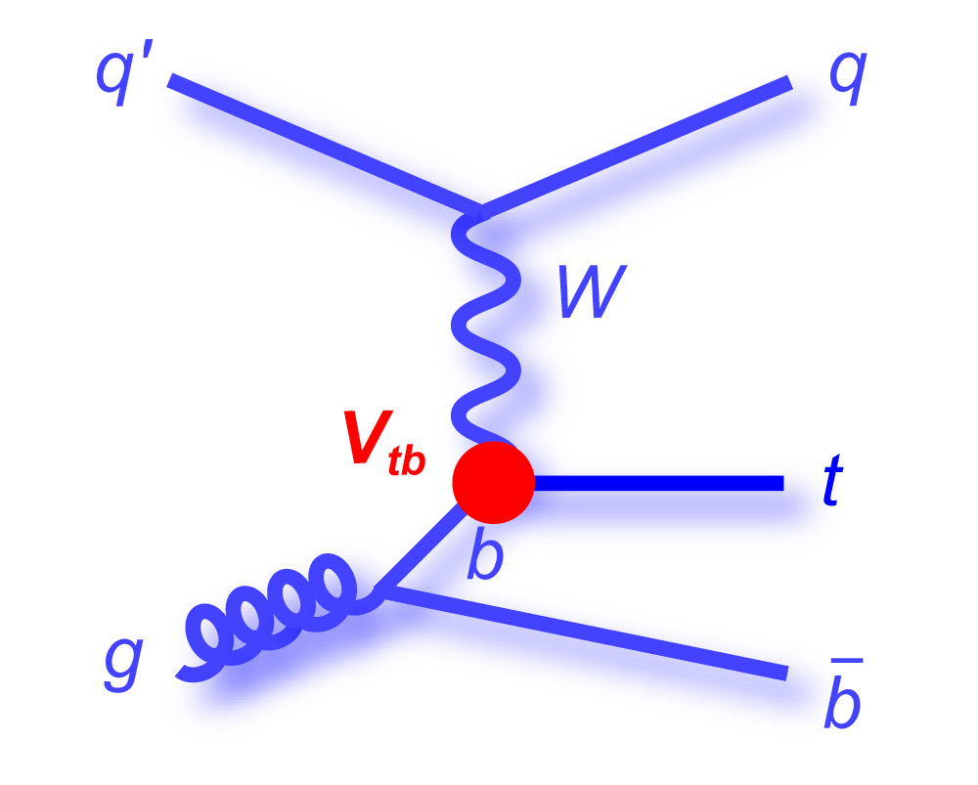
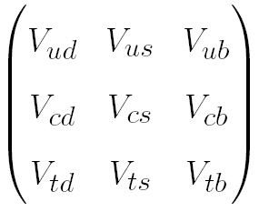
Cross-section and |V_{tb}|
From the inclusive production cross section of single top (t-channel, tW), a value of the CKM matrix element, |V_{tb}|, can be extracted
Considering |V_{td}|, |V_{ts}| << |V_{tb}|
Cross section ~ |V_{tb}|²

Slide 20
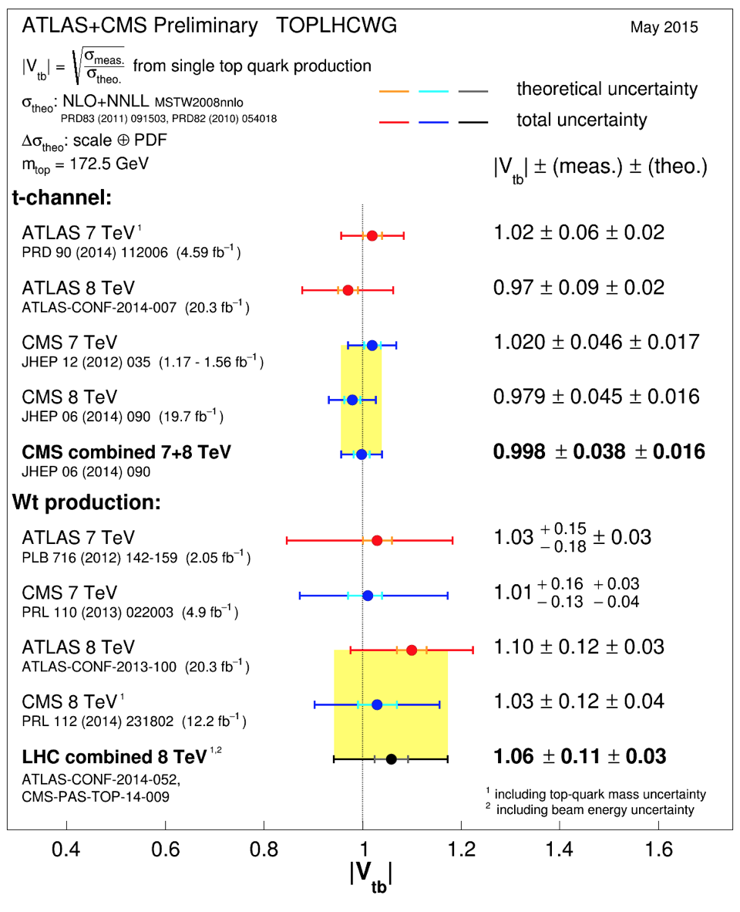
LHC |V_{tb}| summary
Summary plot from TOPLHCWG
May 2015

Slide 21
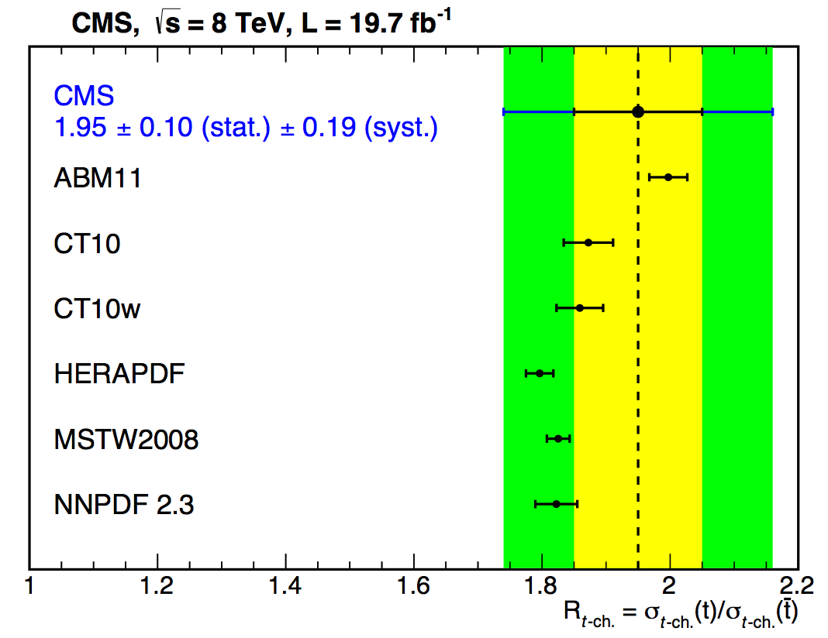
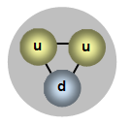
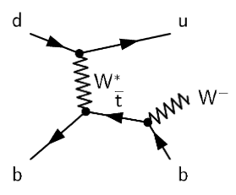
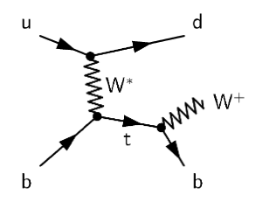
t-channel: R
Within the measurement of the t-channel cross-section at 8TeV, we measure the top/anti-top asymmetry, R
Due to the relative proportion of u and d quarks in the proton, more tops than anti-tops are expected to be produced
σ_{top} = 53.8±1.5(stat.)±4.4(syst)pb | R = 1.95±0.10(stat)±0.19(syst)
σ^{th}_{top} = 54.87 +2.29 -1.94 pb (NLO, latest calculation)
σ_{anti-top} = 27.6±1.3(stat.)±4.4(syst)pb
σ^{th}_{anti-top} = 29.74 +1.67 -1.51 pb (NLO, latest calculation)
JHEP 06 (2014) 090
arXiv:1403.7366

Slide 22
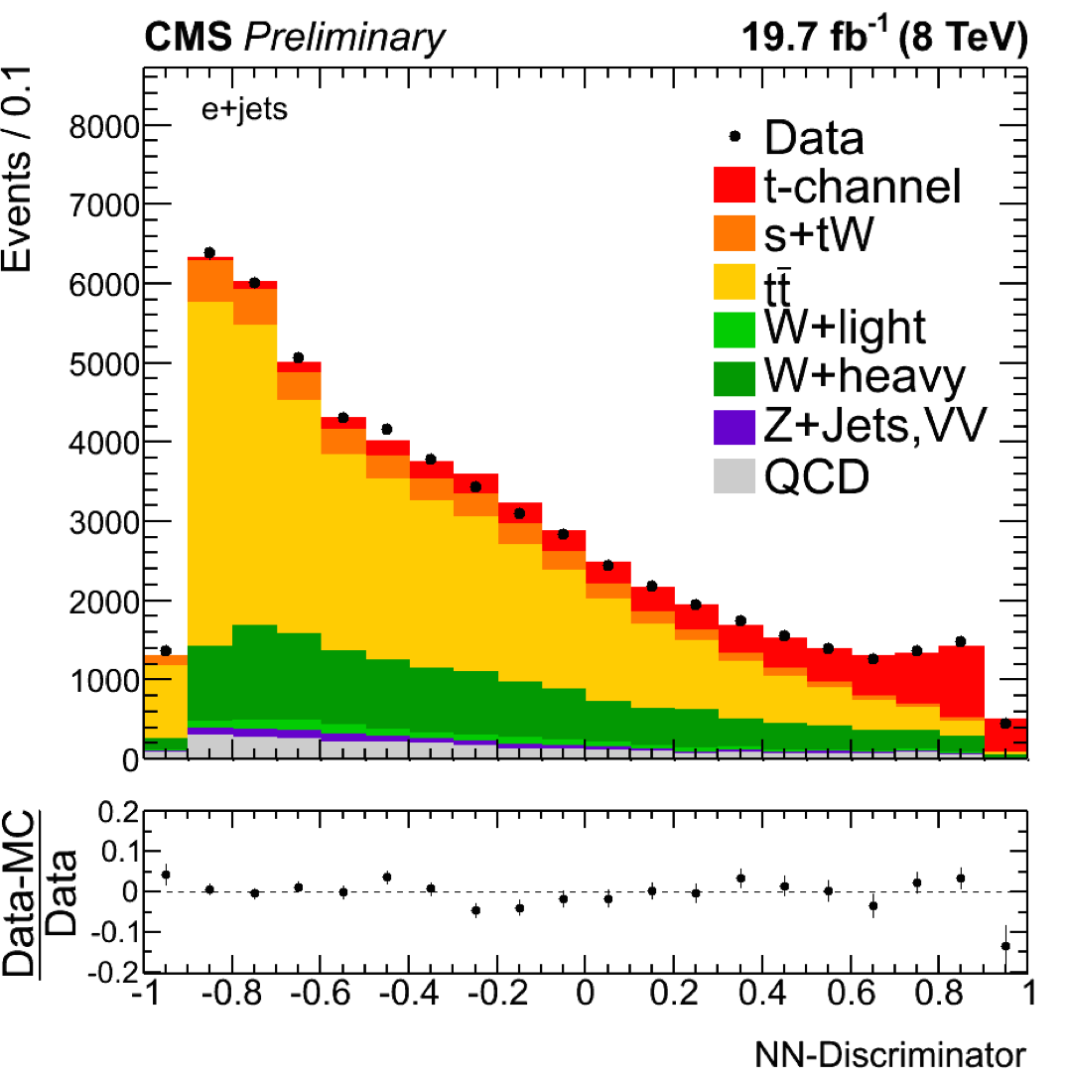
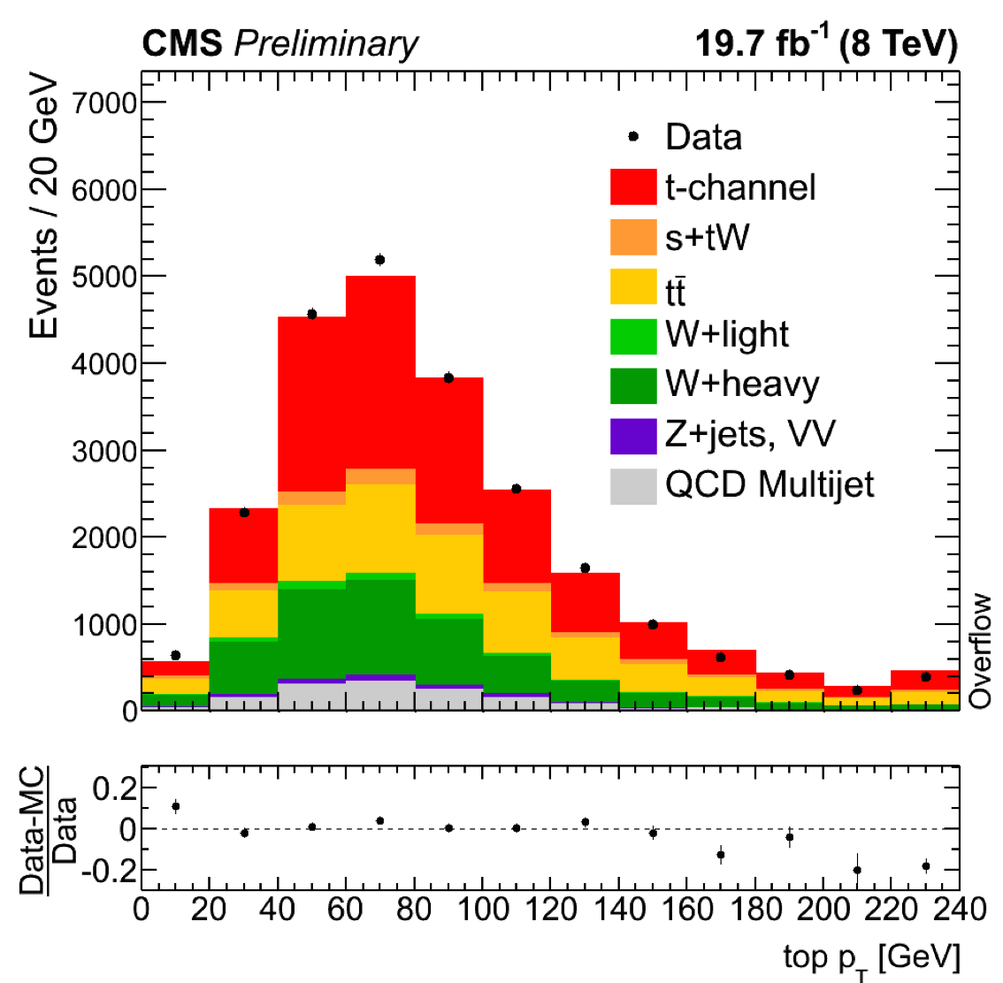
t-channel: differential x-sec
t-channel differential cross section came last September, preliminary
8 TeV, full luminosity
Starting in the same way as the inclusive cross section, the analysis uses a NN to isolate a purer t-channel sample
September 2014
CMS-PAS-TOP-14-004
Events are selected by cutting on an optimal NN discriminant value

Slide 23
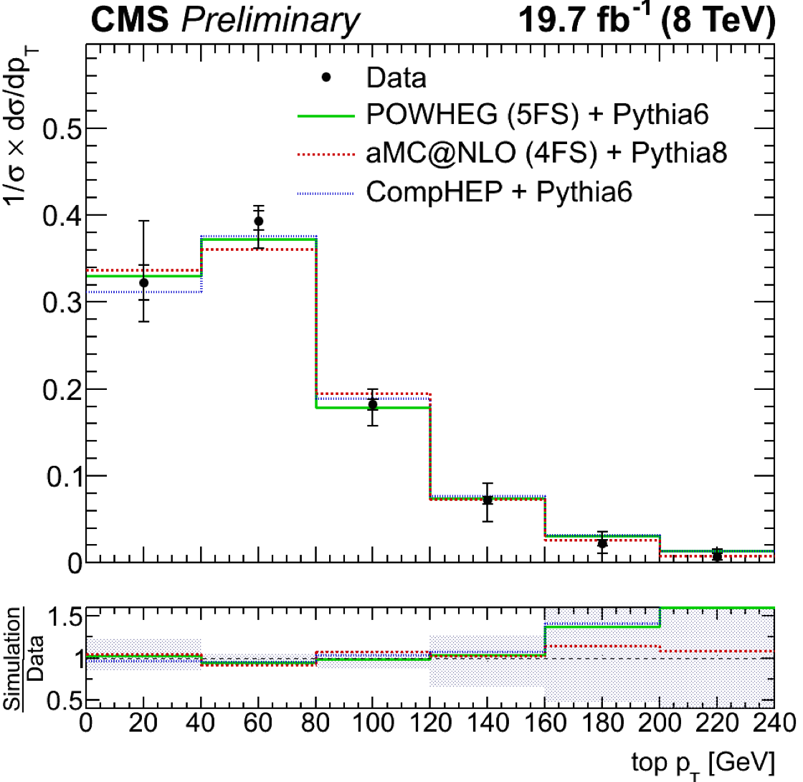
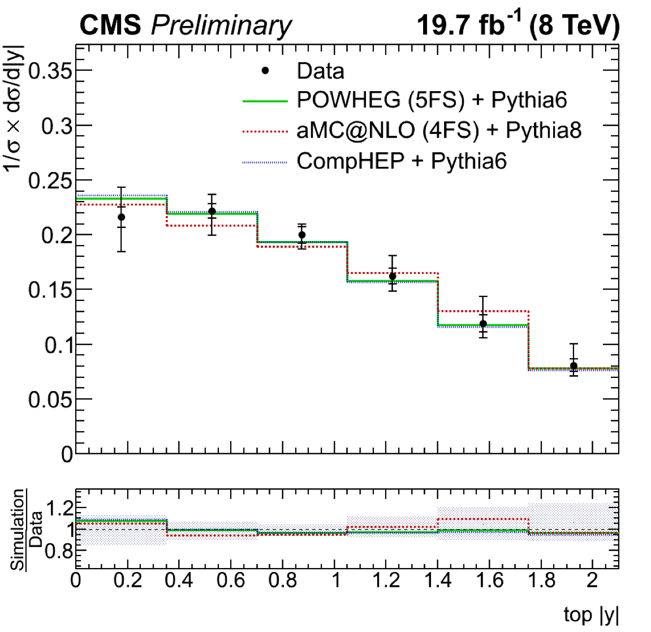
t-channel: differential x-sec
Distributions of the p_{T} and rapidity of the top quarks are then corrected for detector effects (Unfolded) and compared directly with different theoretical predictions:
POWHEG+Pythia (solid), aMC@NLO+Pythia (dotted), and CompHEP (dashed)
CMS-PAS-TOP-14-004

Slide 24
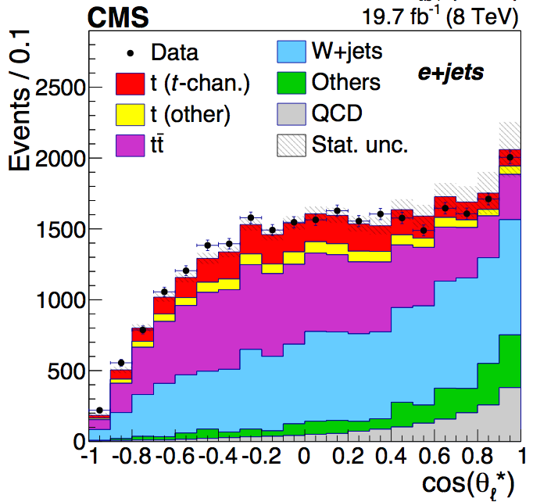
t-channel: W-helicity
Going further than cross section measurements → measurement of the W-helicity fractions
Exact same selection and background estimation as the standard t-channel inclusive cross section measurement
θ*: angle between the W boson in the top rest frame and the lepton in the W rest frame → related to the W-helicity fractions (F₀, F_{L}, F_{R})

Slide 25
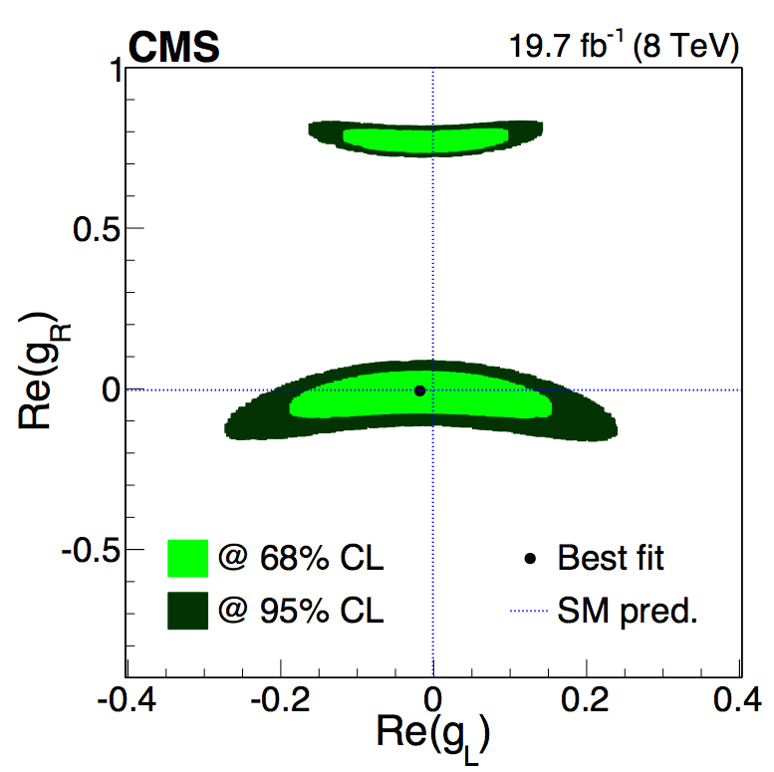
t-channel: W-helicity
Theory prediction (NNLO) | Measured
F_{L} = 0.311 ± 0.005 F_{R} = 0.0017 ± 0.0001 F₀ = 0.687 ± 0.005 PRD 81, 111503(R) (2010) | F_{L} = 0.298 ± 0.028 (stat) ± 0.032 (syst) F_{R} = -0.018 ± 0.019 (stat) ± 0.011 (syst) F₀ = 0.720 ± 0.039 (stat) ± 0.037 (syst)
Using the helicity fractions measured → exclude the tensor terms of the tWb anomalous couplings, g_{L} and g_{R}
October 2014
JHEP 01 (2015) 053
arXiv:1410.1154

Slide 26
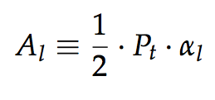
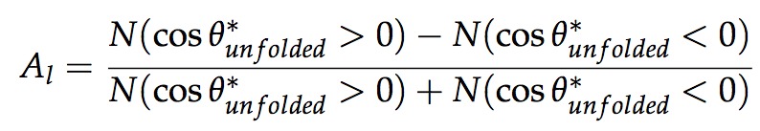
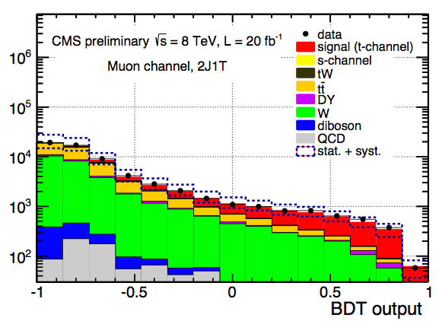
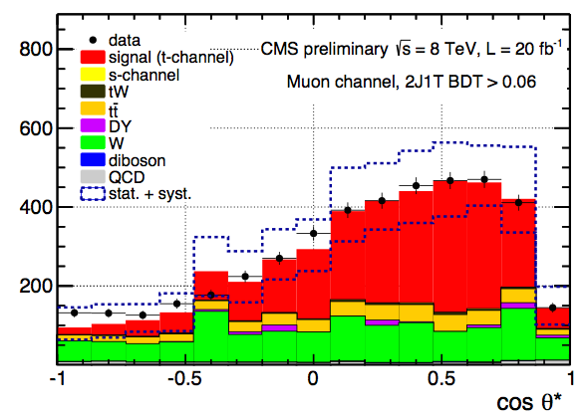
t-channel: top polarization
Single top quarks are highly polarized
spin aligned with the recoiling light jet
The top quark polarization relates to the spin asymmetry
Which can be extracted from the cosθ*_{l} distribution
A BDT is used to get a t-channel enriched sample
August 2013
CMS-PAS-TOP-13-001

Slide 27
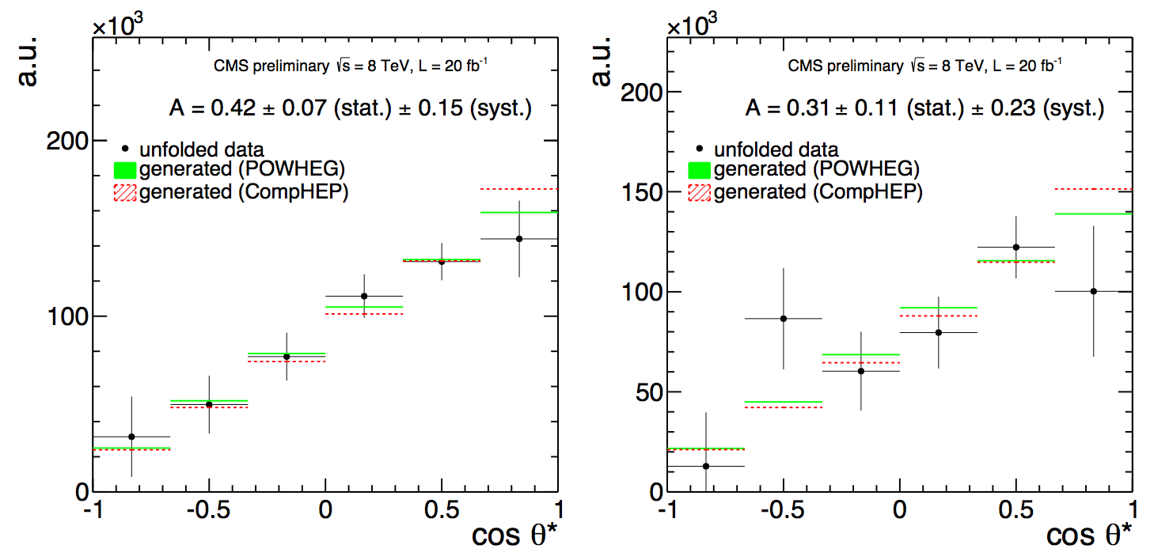
t-channel: top polarization
The asymmetry is obtained from the unfolded distributions in the e and µ channels separately and combined using BLUE
µ
e
A_{l}=0.41±0.06(stat.)±0.16(syst.) (SM expectation 0.44)
P_{t}=0.82±0.12(stat.)±0.32(syst.)
August 2013
CMS-PAS-TOP-13-001

Slide 28
Step III
Search for FCNC and Anomalous Couplings
Limits on anomalous Wtb couplings can be extracted from SM measurements (W-helicity fractions, top polarization)
→ Dedicated analyses searching for deviations from the SM are also in place in single top signatures

Slide 29
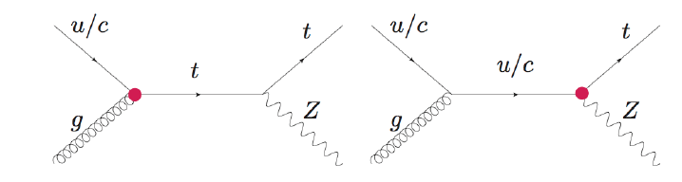
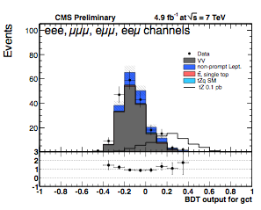
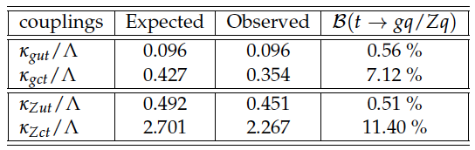
FCNC tZ
July 2013
CMS-PAS-TOP-12-021
FCNC tZ
7TeV
Three-lepton signature
Simulated samples with different scenarios
BDT (gut, gct, Zut, Zct)
No excess → Limits on couplings and branching fractions

Slide 30
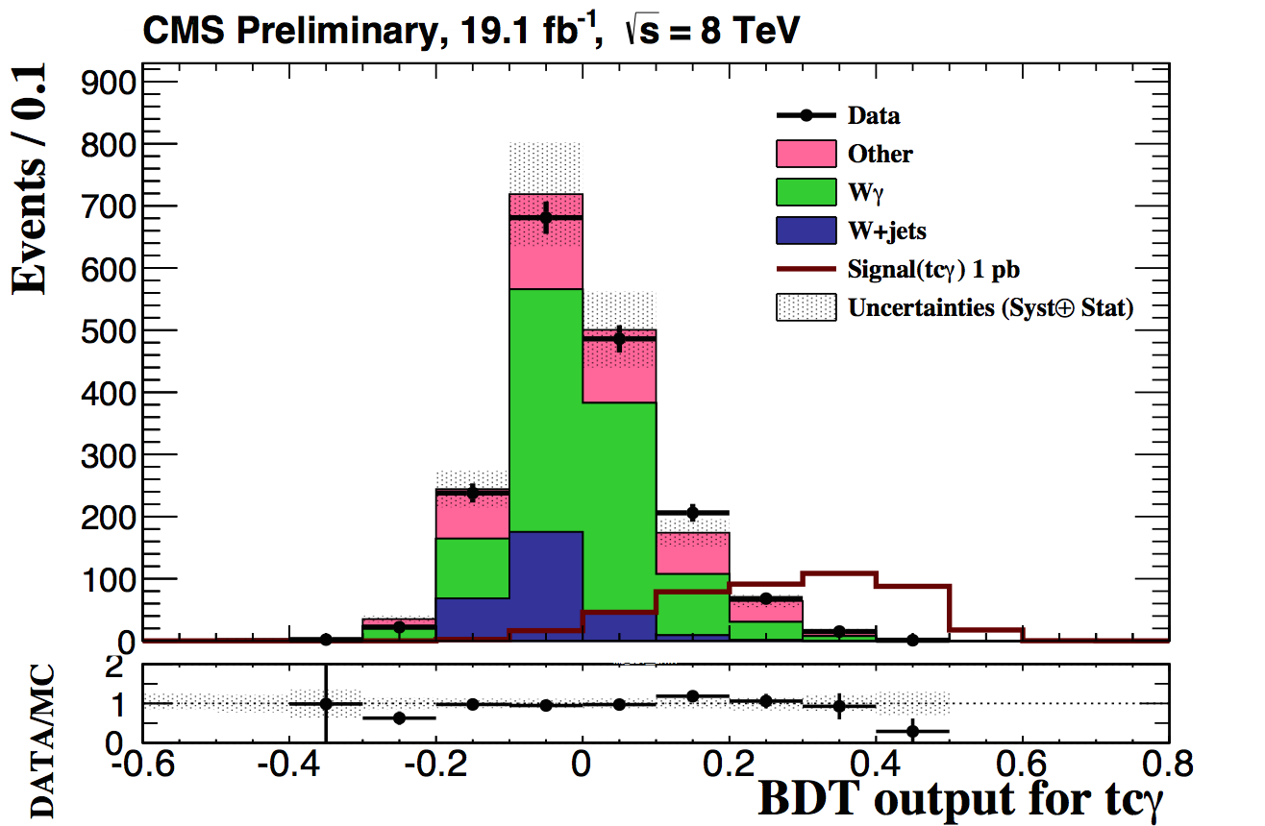
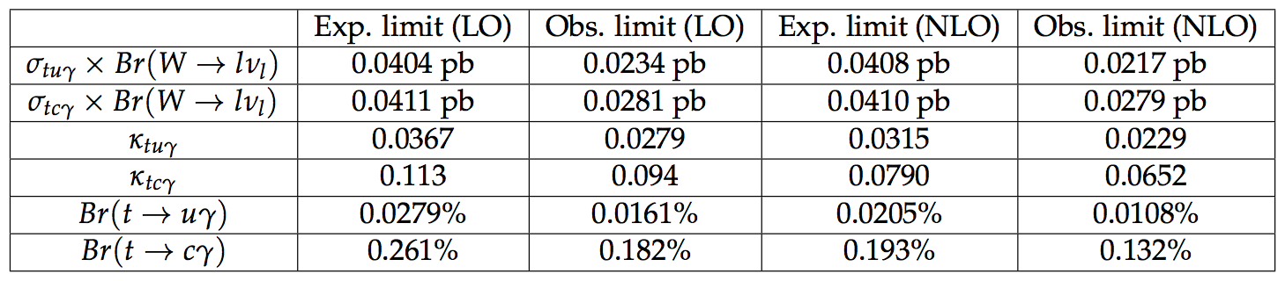
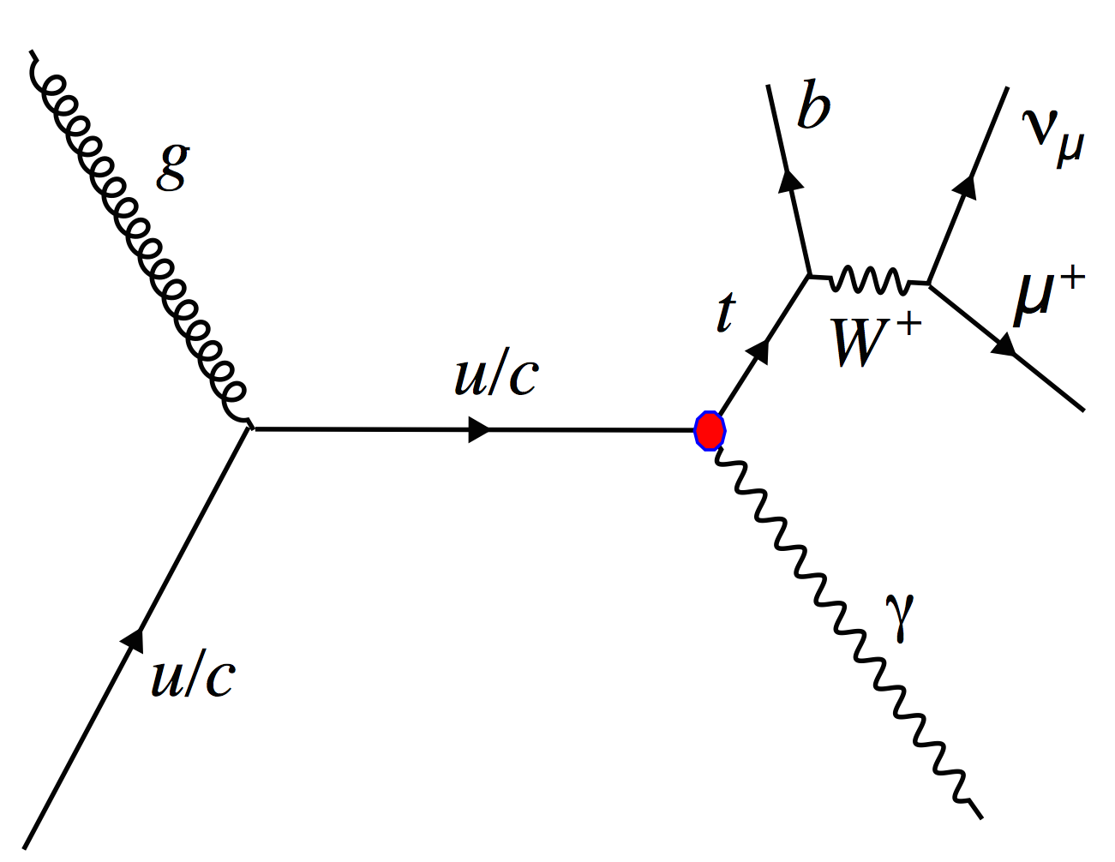
FCNC tγ
tqγ, single top produced in association with a photon
Enhancement on t→u(c)γ BR due to FCNC
8TeV, µ only
Samples with anomalous tuγ, tcγ couplings
Dedicated BDTs
No excess
→ Limits on couplings and branching fractions
May 2014
CMS-PAS-TOP-14-003

Slide 31
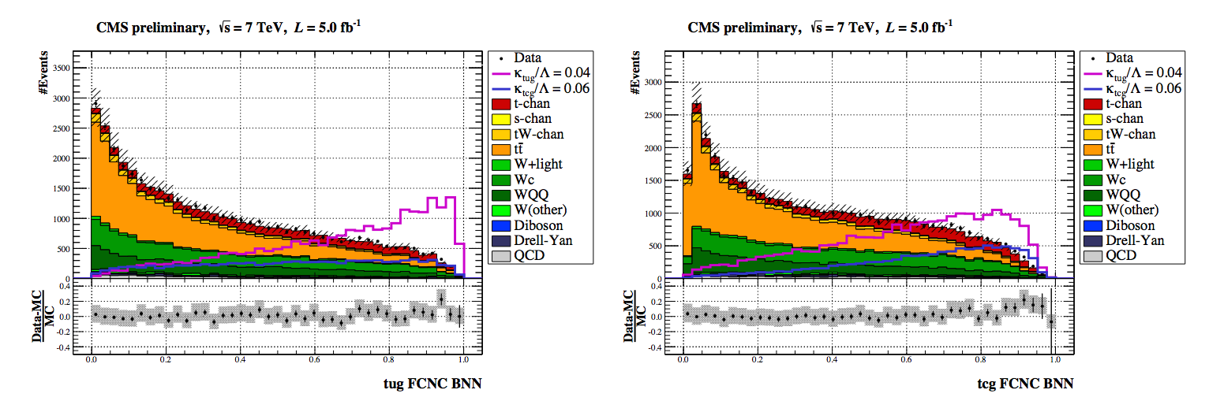
FCNC and AC in t-channel
FCNC and anomalous couplings in t-channel
7TeV, µ
Anomalous operators in the Wtb vertex and tcg/tug FCNC couplings
NN to separate different scenarios considered Vs SM
No excess → Limits on couplings and branching fractions
May 2014
CMS-PAS-TOP-14-007

Slide 32
Summary
Single top signatures were largely unknown until recently
In the last 5 years we have made very good progress
→ the LHC is very powerful for top, and single top in particular
In CMS we have studied the three main production modes
We have used single top quarks produced via t-channel for measurements:
W-helicity fractions, top polarization, |V_{tb}|…
We have explored conventional and rare single top production modes to look for BSM physics: FCNC and Anomalous Couplings
Also (not in this talk): single top+Higgs (see Ken Bloom’s talk on Thursday!), monotops (DM)
Run-2 will be the time to fully explore single top signatures, in particular to look for physics beyond the standard model

Slide 33
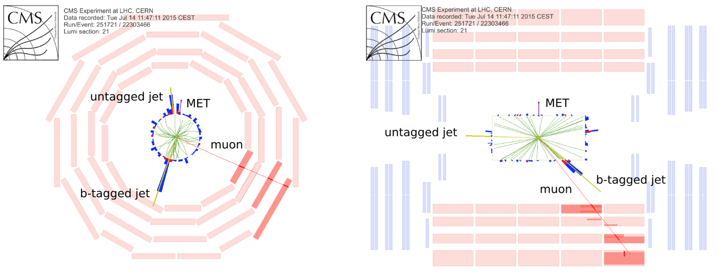
Stay tuned!
Single top candidate event (t-channel, µ)
CMS DP -2015/019
22 July 2015

